Slide 1
CSE115
Lecture 8
Dr. Mohammad Abu Yousuf (MAY)

Slide 2
THE switch STATEMENT
The switch statement causes a particular group of statements to be chosen from several available groups. The selection is based upon the current value of an expression which is included within the switch statement.
The general form of the switch statement is
switch (expression) statement
where expression results in an integer value. Note that expression may also be of type char, since individual characters have equivalent integer values.
The embedded statement is generally a compound statement that specifies alternate courses of action.

Slide 3
THE switch STATEMENT (Cont…)
For each alternative, the first statement within the group must be preceded by one or more case labels (also called case prefixes). The case labels identify the different groups of statements (i.e., the different alternatives) and distinguish then from one another. The case labels must therefore be unique within a given switch statement.
In general terms, each group of statements is written as
case expression :
statement 1
statement 2
. . . . .
statement n

Slide 4
THE switch STATEMENT (Cont…)
or, when multiple case labels are required,
case expression 1 :
case expression 2 :
. . . . .
case expression m :
statement 1
statement 2
. . . …
statement n
where expression 1, expression 2, . . . , expression m represent constant, integer-valued expressions. Usually, each of these expressions will be written as either an integer constant or a character constant. Each individual statement following the case labels may be either simple or complex.

Slide 5
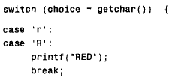
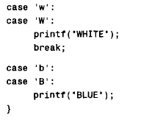
THE switch STATEMENT (Cont…)
Example: In this example, choice is assumed to be a char-type variable.

Slide 6
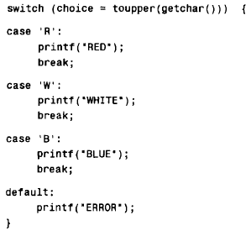
THE switch STATEMENT (Cont…)
One of the labeled groups of statements within the switch statement may be labeled default. This group will be selected if none of the case labels matches the value of the expression.

Slide 7
THE break STATEMENT
The break statement is used to terminate loops or to exit from a switch. It can be used within a for, while, do -while, or switch statement.
The break statement is written simply as
break;
without any embedded expressions or statements.
If a break statement is included in a while, do - while or for loop, then control will immediately be transferred out of the loop when the break statement is encountered.

Slide 8
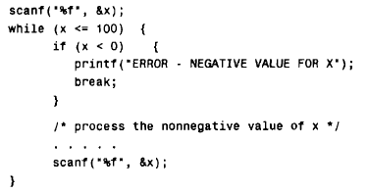
THE break STATEMENT (Cont..)
Example:
Break statement in while loop.

Slide 9
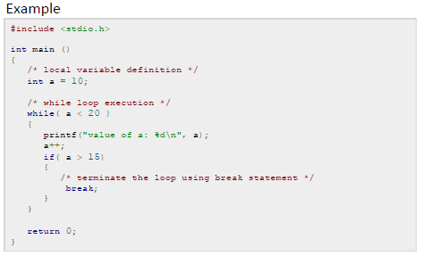
THE break STATEMENT (Cont..)

Slide 10
THE continue STATEMENT
The continue statement is used to bypass the remainder of the current pass through a loop. The loop does not terminate when a continue statement is encountered. Rather, the remaining loop statements are skipped and the computation proceeds directly to the next pass through the loop. (Note the distinction between continue and break.)
The continue statement can be included within a while, a do - while or a for statement.
It is written simply as
continue;
without any embedded statements or expressions.

Slide 11
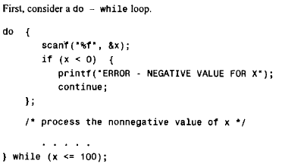
THE continue STATEMENT

Slide 12
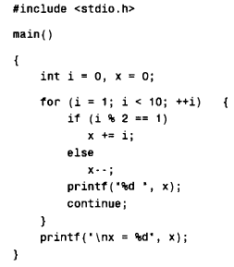
Example continue:

Slide 13
Answer: 1 0 3 2 7 6 13 12 21
X=21

Slide 14
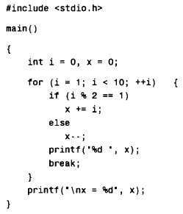
Example break:

Slide 15
Answer: 1
x = 1

